Slide 1
Software Engineering
Tatenda Gorimbo

Slide 2

Mental Health Care Mastery LTD
As a software engineer I would like to create a Mental Health Care Mastery website to make it easy for the clients to book for health practitioners.
The system must contain booking appointment option:
The client must be able to sign in and out with his/her details.
The client must be able to reset passwords.
The client must able to make an appointment from 9a.m to 7p.m
The system must be flexible to use in different devices and operating systems such as windows, macOS , Androids and Linux etc.
The client must be able to access the contact details of the company

Slide 3
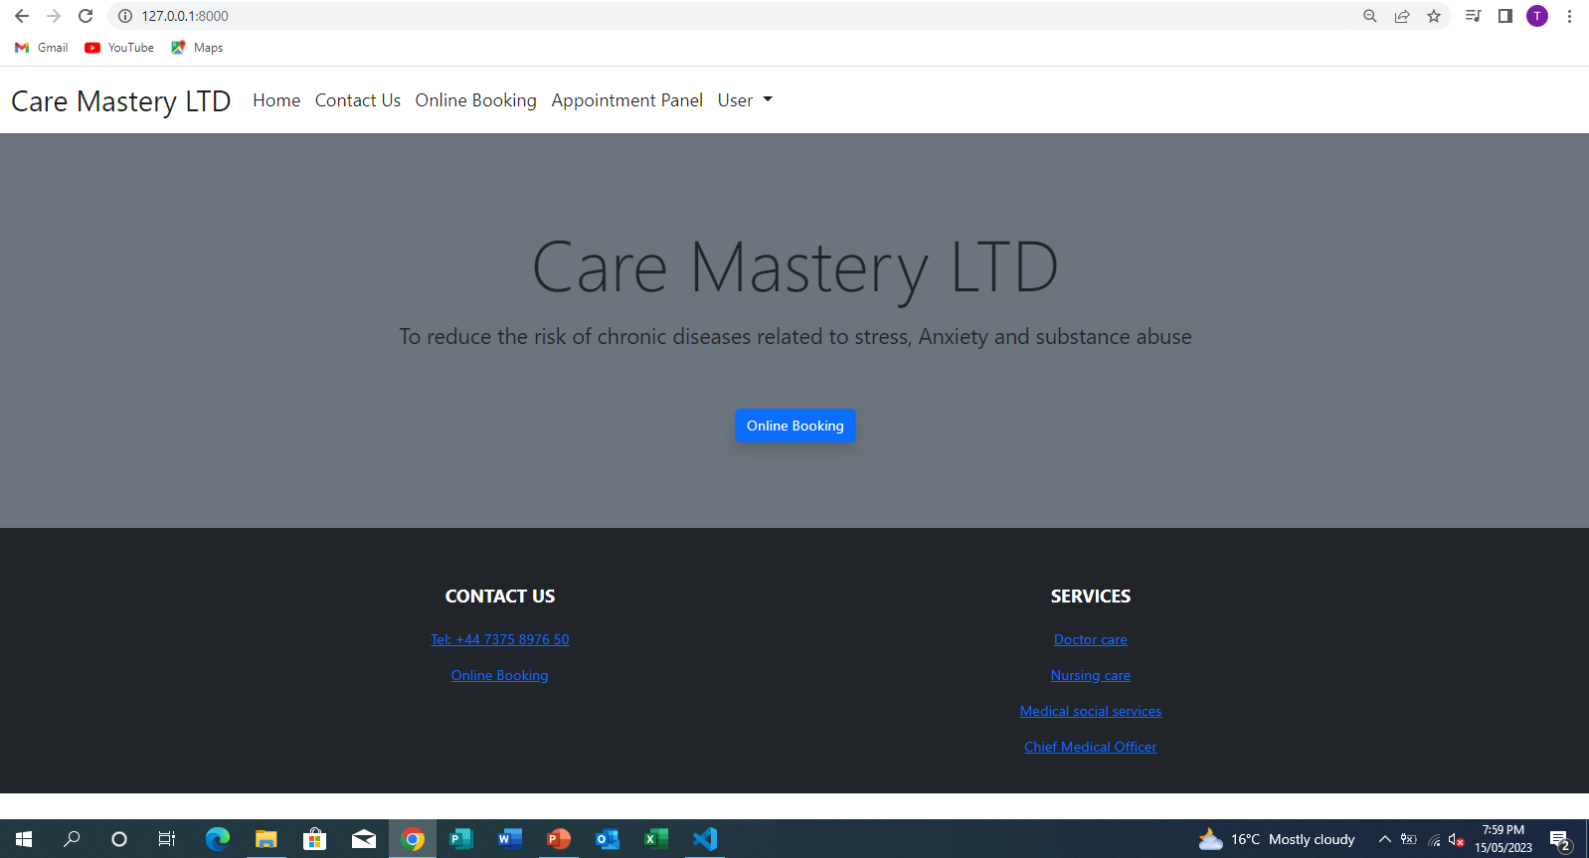
HOME PAGE
Our home page shows :
Name of the company
The motto of the company
Online booking option
Contact us details
Our Services which shows the health practitioners that works for the company
It also shows the other pages such as online booking, appointment panel and user

Slide 4
Requirements Specification
ONLINE BOOKING OPTION:
If you click on online booking it will take you to the page where you can select the type of service you want to book for.
It will also gives you the available dates that you can make the appointment.
When you click continue it will take you to a page where you can select available time for the appointment.
Then as soon as you submit the appointment will be automatically saved.
APPOINTMENT PANEL OPTION:
When you select appointment panel it will immediately take you to the list of the appointment that have been made .
It also have the search appointment option where you can be able to search for the appointment that you have made in case there might be a lot of appointment that have been made before
USER PANEL
It show the information of the person who has booked (user information)
It shows the appointment information and there's and an edit option in case you might want to change the time or date of the appointment.
Then after you are done with editing there's sign out option

Slide 5

MY PRESENTATION VIDEO

Slide 6
Implementation – Care Mastery LTD
Sign up – user can sign up with their own details if they have never signed in before
- Sign up details – Name, surname and passwords
User’s sign up details will be saved and they will be now have an account with the company
Sign in – user can sign in with their details if they already have an account
Online Booking – user can make a booking after signing in
- user cannot make a booking without signing in
- user can book for different services e.g.Doctors,nurses
- user can also choose date for the booking
- user can choose time for the appointment
- user can submit and the appointment will be saved
Editing Appointment – user can be able to edit dates, time and services etc.
- user can also change the date, time and services etc.
User can be able to access the contacting details information
Sign out – user can sign out when they are done with everything

Slide 7
Testing
Description | Data | Expected | Actual | Changes made
Sign in page | Chrome Browser | User must be able to sign | pass | No changes made
username |  | User must be able to use his/her details to sign in | pass | No changes made
Booking appointment |  | User must be able make an appointment | pass | Cancel Appointment
Editing Appointment |  | User must be able to edit the appointment To change date To change time To change the practitioners | Pass Pass Pass Pass | Time changed to SA time Other practitioners were added
Sign out |  | User must be able to sign out | pass | No changes made

